Slide 1
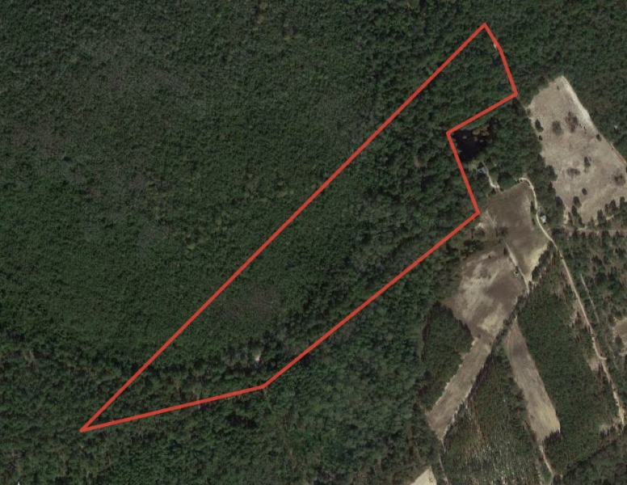
White Oak Hunting Land
Aerial Map
Marty Lanier
(910) 617-4326
mlanier@mossyoakproperties.com
Owners and owner’s agents make no claims as to the accuracy of this map. This is not an official survey.

